Slide 1
Coach Realtors
[Your Name]

Slide 2
Here to Help!
Upload Photo & place here
I AM [your name]
Selling real estate since ____
You can find me at:
[add contact info]

Slide 3
Coach’s Focus
You as a seller to maximize your sales price!

Slide 4
My Marketing Strategy
Professional Photography
Gets a higher price for your home
Photos & FloorPlans
Online Virtual Tours & Offline Marketing
Provide tons of information to the online buyer to help them screen & process

Slide 5
OUR PROCESS IS EASY
1.
Price
Listing
2.
Prepare Marketing
3.
Market
Listing

Slide 6
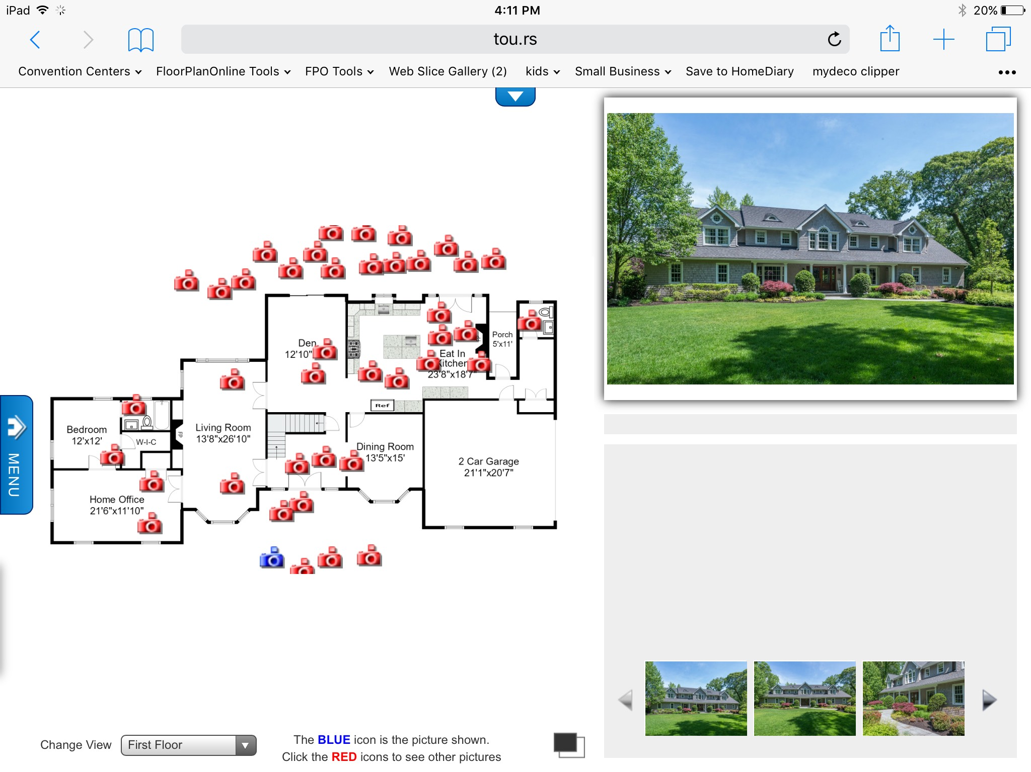
92%
Number of buyers that use the Internet to search for their next home...and 50% of them do it via a mobile device!

Slide 7
I use a combination of online & offline tools to help sell your Home quickly and efficiently

Slide 8
Interactive FloorPlans
Combines Photos with 2D & 3D FloorPlans in easy, point & click navigation

Slide 9
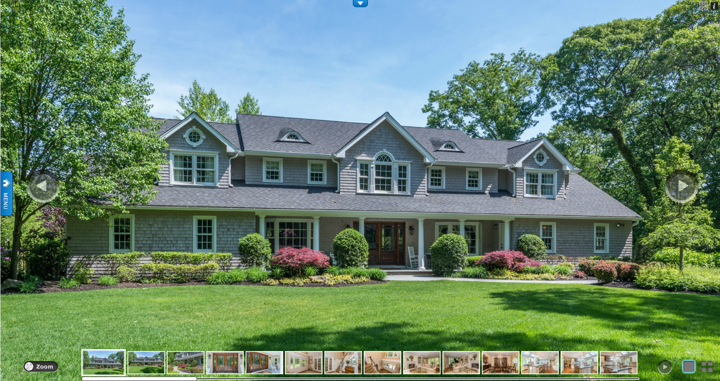
HD Photos
Big, Clear Photo Gallery

Slide 10
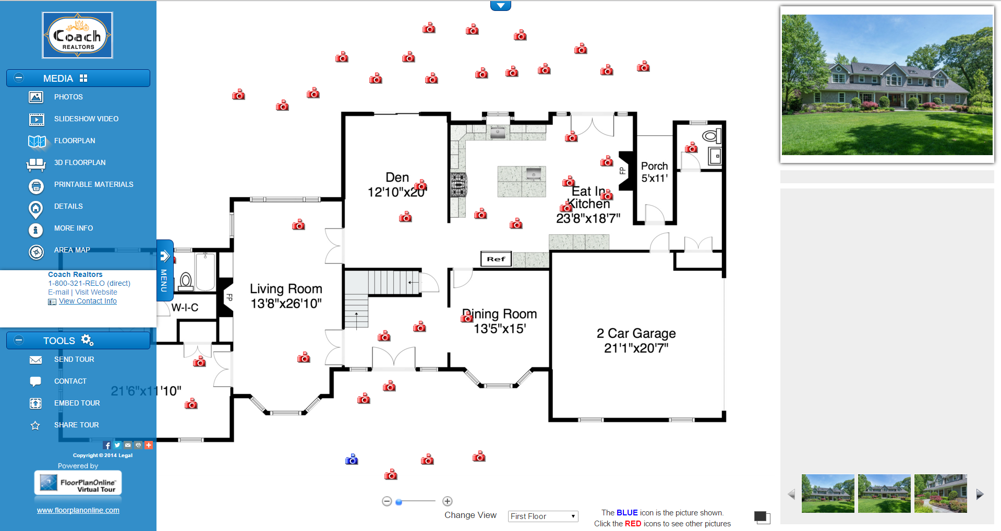
Interactive FloorPlan
Point & Click through Property

Slide 11
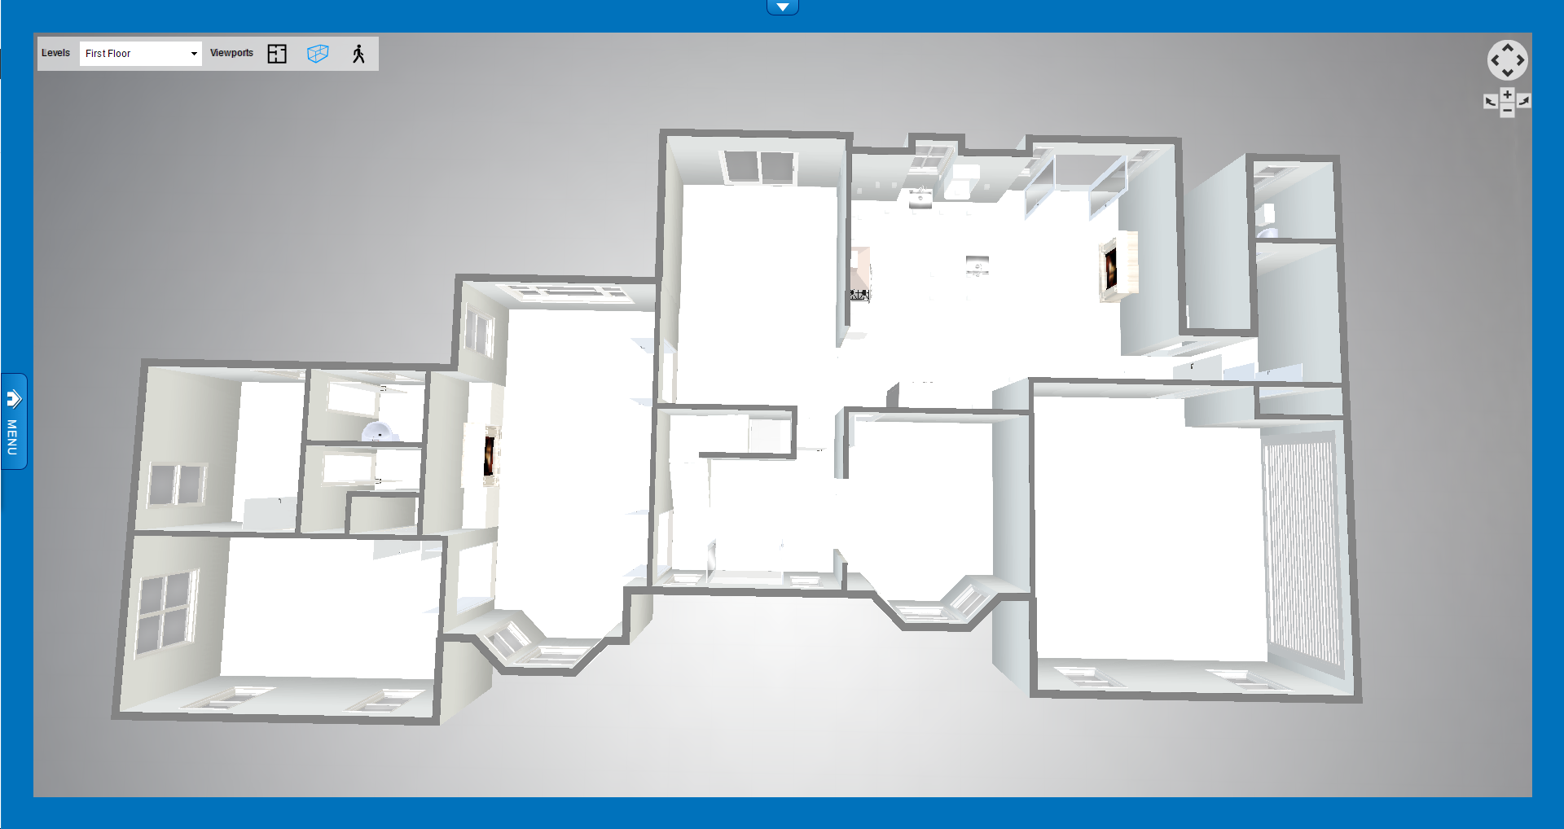
3D FloorPlan
2D, 3D Top & 1st Person Views

Slide 12
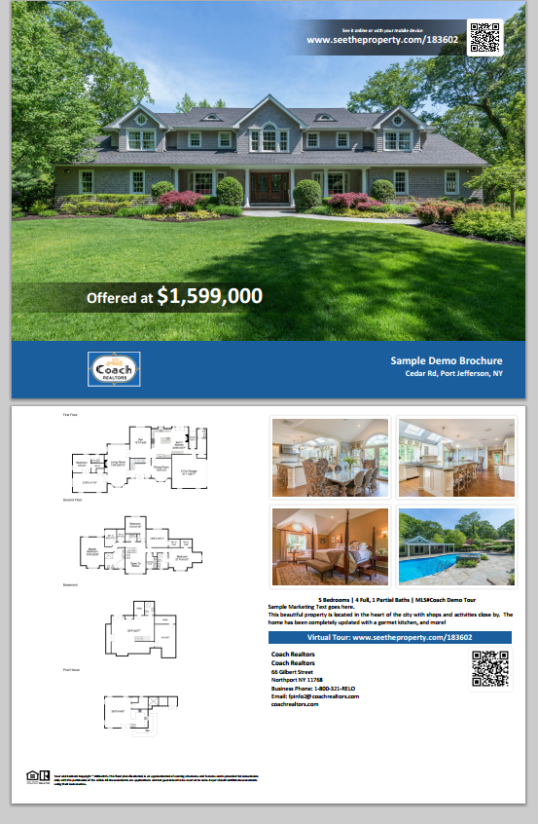
Offline Marketing extends utility
Brochures with FloorPlans help extend marketing to open houses and more...

Slide 13
The Demo Reel
Download this video here.
then right click and Save video as...to your computer

Slide 14
Tour Distribution brings Worldwide Reach
our office

Slide 15
1.2 Billion$
___ transaction
100%
Total Coach Transaction volume in 2015
Closed Transactions
Total success!

Slide 16
THANKS!
Any questions?
You can find me at:
[ your contact info]

